Slide 1
Data Analysis of Agricultural Yield Factors
Exploratory Data Analysis (EDA) Findings
Name – Sumit Baviskar
Date - 29 Septmeber 2024

Slide 2

Introduction
Brief Overview of the Project.
Importance of EDA in Agriculture.
Objectives of the Analysis.

Slide 3
Data Overview
Key Variables
Rainfall.
Temperature.
Soil Type.
Crop Yield.
Fertilizer.
Irrigation.
Region.
Weather Condition.
Days to Harvest.
Yield tonnes per hectare.

Slide 4
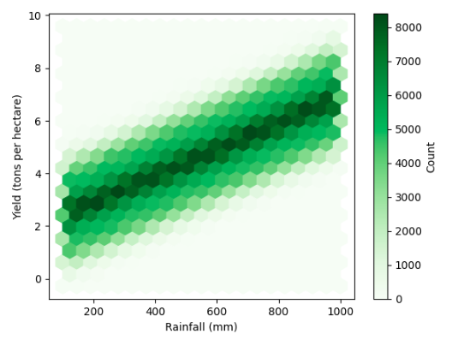
Rainfall and Yield Relationship
Positive correlation between rainfall and crop yield.
Variability in yield based on other factors.
Yield at Extreme Rainfall Levels.

Slide 5
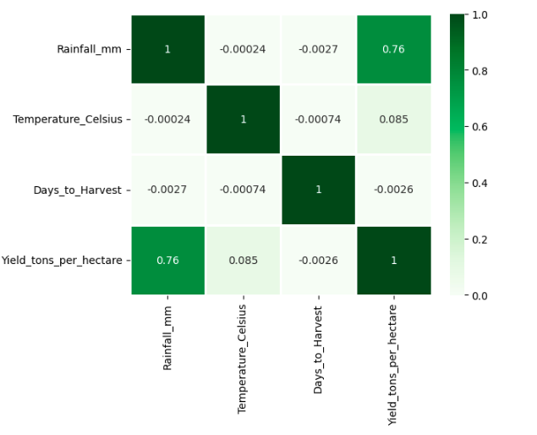
Temperature’s Limited Impact
Strong positive correlation between rainfall and yield.
Days to Harvest is negatively correlated (but value is too close to zero) to Rainfall and Temperature.
No significant relationship between days to harvest and other variables.
Other factors may have more significant effects.

Slide 6
Fertilizer and Irrigation Impact
Significant yield enhancements with fertilizer and irrigation.
Consistent Positive Impact.
Effectiveness across various crops and regions.
Largest Yield Improvement with Fertilizer and Irrigation.
Yield is Less compared to yield with fertilizers.

Slide 7
Fertilizer effect on Day to harvest
Crops consistently show the highest yields when fertilizer is applied, regardless of the amount of rainfall.
Combining fertilizer use with good water management practices leads to sustainability in agricultural systems.
Fertilizer application not only boosts yields but also crops optimize water use, .
Use of fertilizer allows crops to make better use of available water, significantly boosting yields

Slide 8
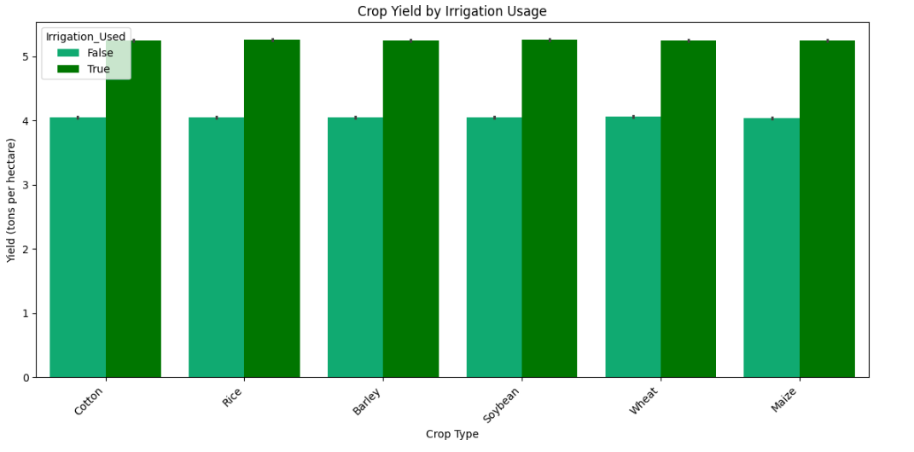
Crop and Irrigation Compatibility
Rice, Barley, Wheat, and Maize show the most significant difference in yield between irrigated and non-irrigated conditions.
Cotton and Soybean also show yield improvement with irrigation, but the difference appears to be slightly smaller compared to the other crops.
Rice and Maize have the highest yields under irrigation conditions.
Barley and Wheat have the lowest yields without irrigation,

Slide 9
Recommendations for Farmers
Optimize Water and Fertilizer Management
Focus on Rainfed Crops.
Adapt to Regional Conditions.
Monitor and Adjust Based on Weather.
Explore Further Factors Affecting Yield Variability

Slide 10
Conclusion:
Importance of EDA in uncovering insights
Data-driven decision-making for improving agricultural productivity
Future analysis directions and possibilities

Slide 11

Q&A
Open the floor for questions

Slide 12
Thank You
LinkedIn - https://www.linkedin.com/in/sumit-baviskar/
Portfolio - https://sumit-baviskar.github.io/Sumit_Baviskar_PortFolio/
Github - https://github.com/Sumit-Baviskar?tab=repositories

